Slide 1
Presentation on…
Royal Dine™
(A Smart Meal Management System)
Presented by
Md Mahbub alam
ID: 151-35-848

Slide 2
About System
Royal Dine™ is a project which is targeted to keep calculation track easily of regular meals of a student mess, hostel or this type of houses.
This system can be used in any hostels who wants their calculation to be automated, meal system, bazar notification should be automated.

Slide 3
System features
Different Accounts for different User Type
System Notification Message (Bazar Schedule/Other Notice)
Manage Accounts & Meals (View, Add, Delete, Cancel)
List all Members, Meals, Cost Estimation, Bazar Schedule etc
Profile Management
Sort according to month/year
Adding Guest Meal Facility
Cost Estimation Statistics (monthly/yearly)
Master Admin Panel & so on…

Slide 4
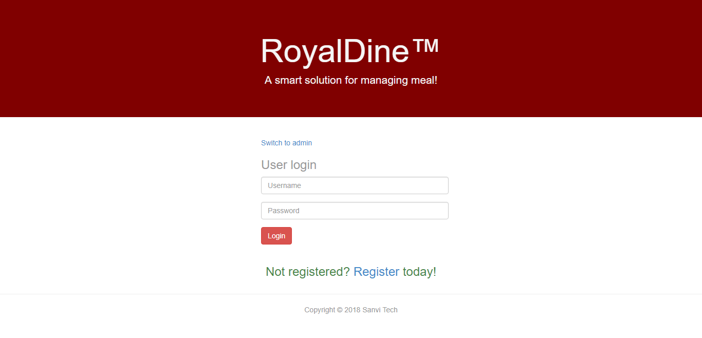
System UI

Slide 5

Royal Dine (video overview)

Slide 6
Thank you

